Slide 1
Jetpack Compose

Slide 2
AGENDA
Basics of Jetpack Compose
State Management
Theming and Styling
Navigation in Jetpack Compose
UI Components & Widgets
Animations
Interaction and Gestures
Testing Jetpack Compose UIs
Advanced Topics
Coroutines and Jetpack Compose
Jetpack Compose for Desktop

Slide 3
Topics
Basics of Jetpack Compose
Layouts of Jetpack Compose
UI Components & Widgets
State and Lifecycle
Theming and Styling
Navigation
Animations
Interaction and Gestures

Slide 4
What is Compose?
Jetpack Compose is a modern UI toolkit recently launched by Google which is used for building native Android UI.
It is a Jetpack library, not a part of framework.
It simplifies and accelerates the UI development with less code, Kotlin APIs, and powerful tools.
Basic Building Blocks – Composables(Kotlin Function with @Composable)

Slide 5
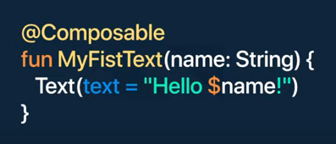
Functions of Jetpack Compose
Composable Function
Represented by @Composable annotation

Slide 6
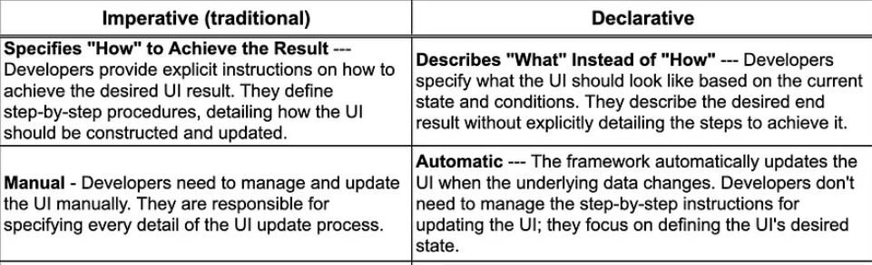
Imperative Vs Declarative

Slide 7
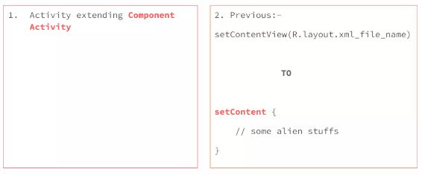
Major Differences

Slide 8
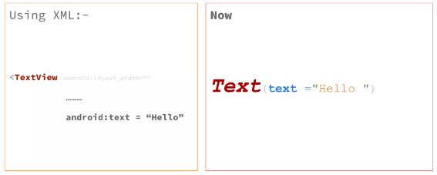
Rendering TextView(XML) Vs Text(JC)

Slide 9
Preview Function
Represented by @Preview annotation
It is used to display a preview of our composable functions within our IDE rather than installing our APK in an emulator or a virtual device.

Slide 10
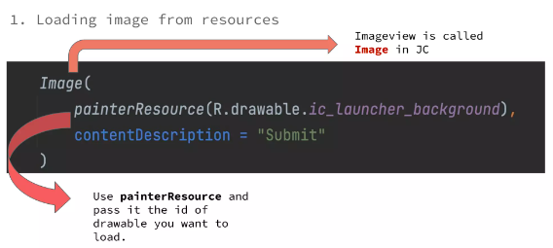
Image

Slide 11
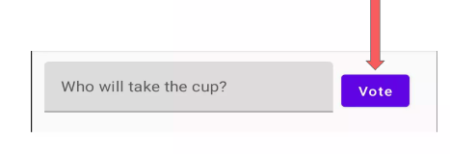
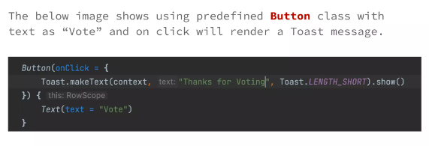
Button

Slide 12
View Groups in Jetpack Compose
Row
Column
Box

Slide 13
Column
Column Function:
It is annotated with Column().
This function will stack all the children directly one after another in a vertical manner with no spacing between them.

Slide 14
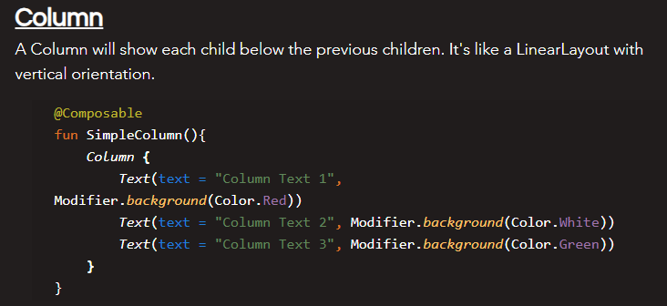
Column Snippet

Slide 15
Row
Row Function
It is annotated with Row().
This function will stack all the children one after the other in a horizontal manner with no spacing between them.

Slide 16
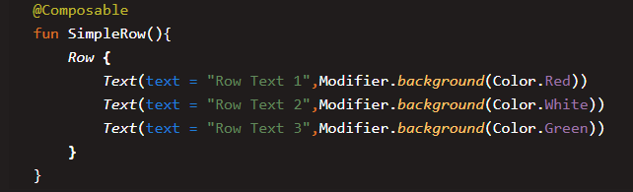
Row Snippet

Slide 17
Box
Box
It is annotated with Box().
A Box is a layout composable that is used to place children relative to its edges.
Initially, Stack was used in place of Box. But now, Stack is deprecated and Box is introduced.
As the name suggests, the children are placed inside parent.

Slide 18
Modifiers
To Modify, display, appearance and behavior of the composable
Size, Background Color, Paddings, Click Handlers
Can be changed and sequence matters

Slide 19
Life Cycle of Composables

Slide 20
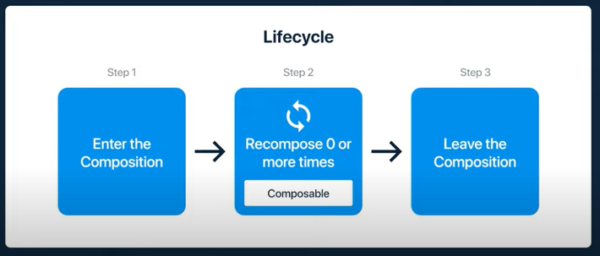
Recomposition
Whenever your state changes , it will recreate the UI.

Slide 21
UI Components
Text, Button, EditText
Switch, Radio Button, Checkbox
Floating Action Buttons
Material design Buttons
Icon Toggle Button, Circular Button
Card
Snackbar, Navigation Bar
Image

Slide 22
UI Layouts
Constraint Layout
Scaffold
List View
Lazy Composables – Row, Column, Grid
Staggered Grid View

Slide 23
Animations
Text Fade-in/out
Expandable Text
Background Color
Drawing Circle
Rotation
Drawing a Line

Slide 24
Navigation and State Management
Navigation Component
Navigation with sending data
State management
Navigation Drawer
Close application Button

Slide 25
Benefits
Declarative
Compatible
Increase development speed
Concise and Idiomatic Kotlin
Easy to maintain
Written in Kotlin

Slide 26
Firebase and Backend Integration
Grid View using Firebase
Add data to Firebase
Retrieve data , Image from firebase
Update to firebase
Phone Authentication

Slide 27
Integration and Data Handling
API Integration and Google Maps(adding markers, drawing polylines)
Exact data from PDF File

Slide 28
Contd..
Recycler View
View Group that contains the views corresponding to your data.
It's a view itself, so you add Recycler View to your layout the way you would add any other UI element.
Each individual element in the list is defined by a view holder object.

Slide 29
ImageVew
Loading Image from resources
Loading image from Url
We will explore using “Coil “ library
Setting Aspect Ratio of image

Slide 30
Image Contd..
Loading Image from URL
In JC, We have to use third party library such as coil
Steps
Add Coil Dependency
Implementation “ io.coil –kt:coil compose:version“
Add Internet permission
<uses-permission android:name-”android.permission.INTERNET”/>

Slide 31
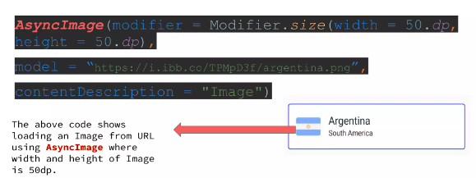
Load Image From URL

